Slide 1
7. X-bar Theory Bar-level Projections, Generalizing the Rules: The X-bar Schema, Complements, Adjuncts, and Specifiers, and Adjuncts in NPs, VPs, AdjPs, AdvPs, and PPs, The Notion Specifier, Parameters of Word Order.
ENG467: Syntax and Structures of Language
Start slide – 8, 20, 29, 46

Slide 2
Introduction
As we saw in the last module, the theory of sentence structure that we've developed is quite powerful.
It correctly predicts constituency and, - along with structural relations and the binding theory - it also accounts for the structural restrictions on the interpretation of pronouns, anaphors, and R-expressions.
This said, if we look a little more closely at sentence structure in many languages, we see that our theory has some empirical inadequacies. (It can't account for all the data.)
Consider, for example, the subject NP in the sentence in (1):
1) [The big book of poems with the blue cover] is on the table.

Slide 3
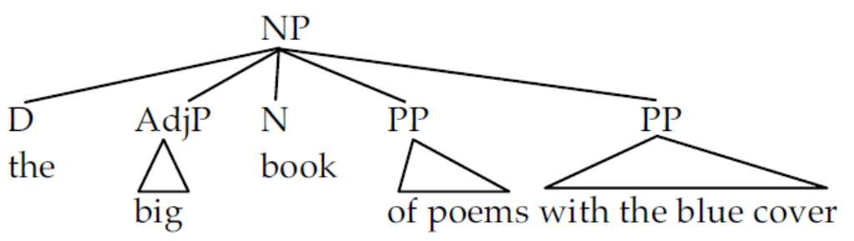
The structure our NP rule NP ➔ (D) (AdjP+) N (PP+) assigns to this is:
2)
We can call this a flat structure.
The PP of poems and the PP with the blue cover are on the same level hierarchically; there is no distinction between them in terms of dominance or c-command.
In other words, they are "flat" with respect to the head word book.

Slide 4
From the point of view of constituency, we see that a number of tests point towards a more complicated structure.
Consider first the constituency test of replacement.
There is a particular variety of this process, called one-replacement, that seems to target precisely a group of nodes that don't form a constituent in the tree in (2):
3) I bought the big [book of poems with the blue cover] not the small [one].
Here, one-replacement targets book of poems with the blue cover. [means targets that constituent]
This group of words does not form a constituent in the tree in (2).
Furthermore, one-replacement seems to be able to target other subgroups of words that similarly don't form constituents in (2):
4) I bought the big [book of poems] with the blue cover, not the small [one] with the red cover.

Slide 5
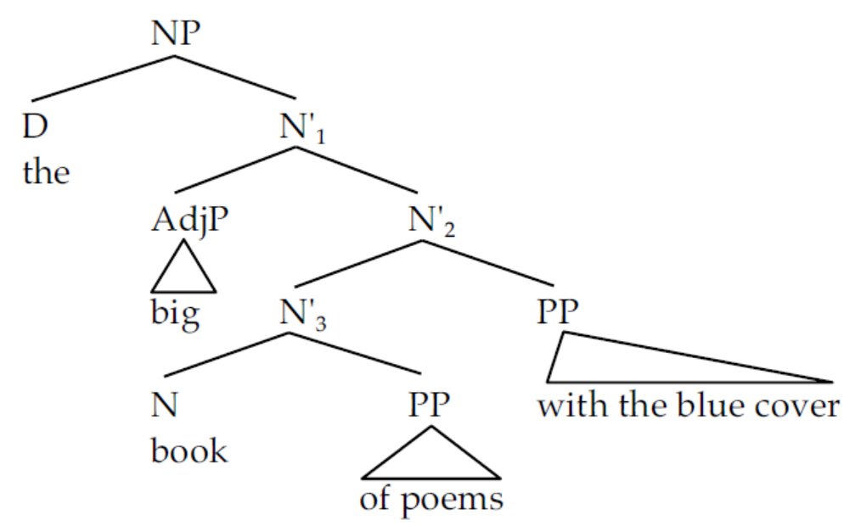
These facts seem to point to a more deeply embedded structure for the NP:
5)
The one-replacement in (4) targets the node labeled N’₃.
The one-replacement in (3) targets the node labeled N’₂.
We have to change the NP slightly to get evidence for N’₁.

Slide 6
If we change the determiner the to the determiner that, we can use one-replacement to target N’₁·
6) I want [_{NP} this [_{N} big book of poems with the blue cover]] not [_{NP} that [_{N} one]].
Therefore, we can say the whole subject NP is a complex NP constituent:
[The big book of poems with the blue cover] is on the table. (=from previous example 1)
Subject verb ‘be’ location
Similar evidence comes from conjunction:
7) Calvin is [the [dean of humanities] and [director of social sciences]].
8) Give me [the [blue book] and [red binder]].

Slide 7
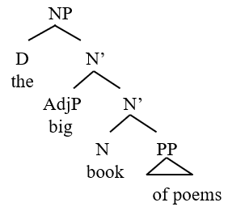
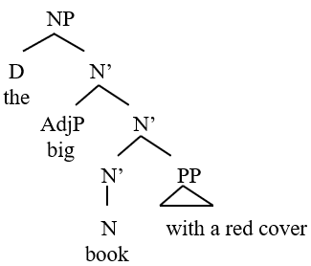
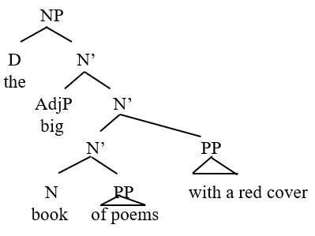
We can also check what forms constituent in the sentence this way:
[The big book of poems with the blue cover] is on the table.
a. the big book [of poems]
b. the big book [with a red cover]
c. the big book [of poems] [with a red cover]
d. the [big [book [of poems] [with a red cover]]]
This suggest the flat structure was not accurate one.
So, there is hierarchy within the NP.

Slide 8
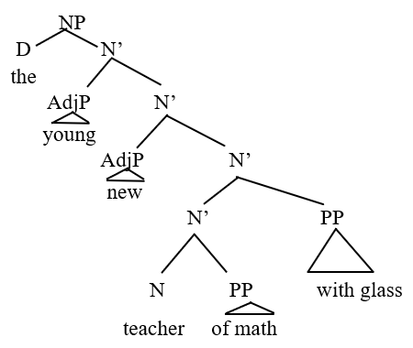
Again, see this one replacement to check what forms constituent in the sentence:
a. The [young [new [[teacher [of math]] [with glasses]]]].
b. The young new [one] with glasses.
c. The young new [one]
d. The young [one]
e. The [one]
This suggest the flat structure was not accurate one.
So, there is hierarchy within the NP.

Slide 9
We need these "intermediate" N' (pronounced "en-bar") categories to explain the items that are conjoined in these sentences.
The flat structure seen in (2) is clearly inadequate and a more articulated structure is needed. This module is about these articulated trees. The theory that accounts for these is called X-bar theory.
So, X-bar theory is a linguistic model that explains how phrases are structured and how syntactic categories are formed.
Definition of X-bar theory:
X-bar theory is a linguistic model that says every phrase in every sentence in every language is organized the same way. Every phrase has a head, and each phrase might contain other phrases in the complement or specifier position.

Slide 10
1. BAR-LEVEL PROJECTIONS
In order to account for the data seen above in the introduction, let us revise our NP rules to add the intermediate structure:
9) NP → (D) N'
10) N’ → (AdjP) N’ or N' (PP)
11) N’ → N (PP)
These rules introduce a new character to our cast of nodes. This is the N' node.
It plays the role of the intermediate constituent replaced by one above.

Slide 11
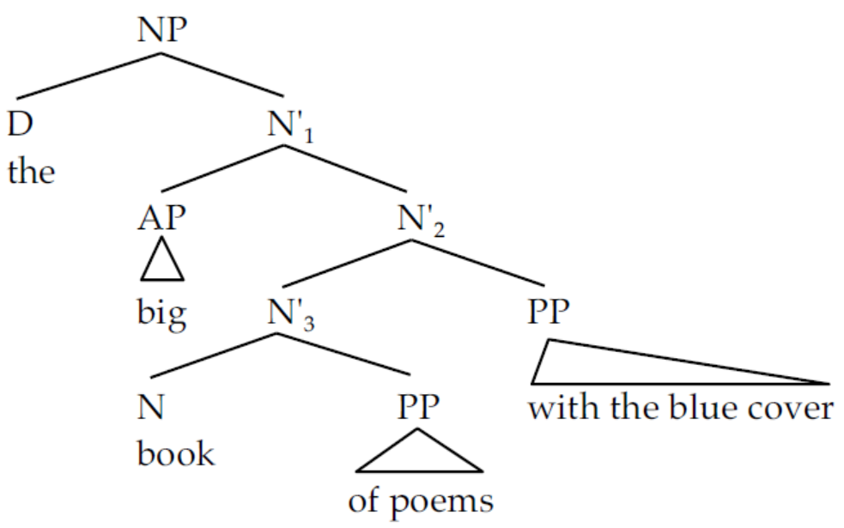
The tree in (5) is repeated here showing how these rules (9-11) apply.
12)
Rule (9) generates the NP node of this tree, with its daughters D and N’.
The first version of rule (10) generates N'₁· The second version of rule (10) generates N’₂.
Finally, the last rule (11) spells out N'₃ as N and its PP sister.
We can now straightforwardly account for the one-replacement sentences. One replacement is a process that targets the N' node:

Slide 12
13) One-replacement: Replace an N' node with one.
Without the intermediate N' node, we would have no way of accounting for one replacement or conjunction facts.
With N', explaining these sentences is easy, since there is more structure in each phrase.
The rule system in (9-11) has a number of striking properties (including the facts that it is binary branching and the first N' rule is iterative or self-recursive).

Slide 13
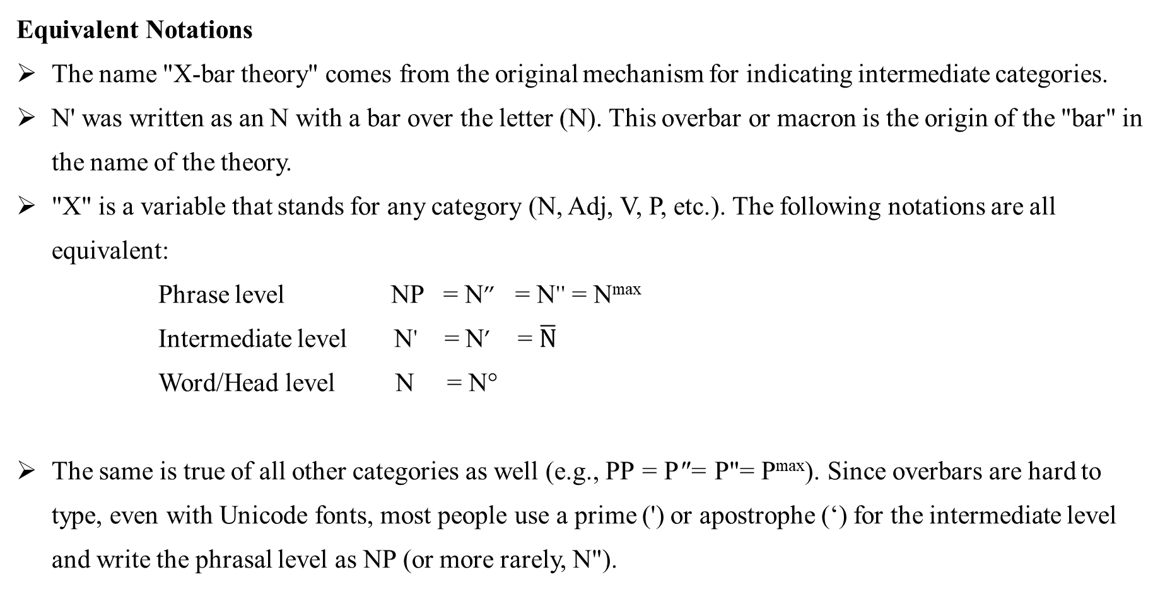
Equivalent Notations
The name "X-bar theory" comes from the original mechanism for indicating intermediate categories.
N' was written as an N with a bar over the letter (N). This overbar or macron is the origin of the "bar" in the name of the theory.
"X" is a variable that stands for any category (N, Adj, V, P, etc.). The following notations are all equivalent:
Phrase level NP = N” = N'' = N^{max}
Intermediate level N' = N’ = $\overline{N}$
Word/Head level N = N°
The same is true of all other categories as well (e.g., PP = P"= P"= P^{max}). Since overbars are hard to type, even with Unicode fonts, most people use a prime (') or apostrophe (‘) for the intermediate level and write the phrasal level as NP (or more rarely, N").

Slide 14
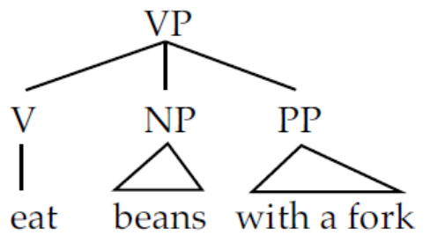
1.1 V-bar
There is a similar process to one-replacement in the syntax of VPs. This is the process of do-so- (or did-so-) replacement. Consider first the VP in the following sentence, which has both an NP and a PP in it.
14) I [eat beans with a fork].
The rule we developed for VPs in previous module generates the following flat tree:
15)
In this tree, there is no constituent that groups together the V and NP and excludes the PP.
However, do-so-replacement targets exactly this unit:
16) I [eat beans] with a fork but Janet [does (so)] with a spoon.
Let's formalize this rule as:
17) Do-so-replacement: Replace a V' with do so (or do or do so too or do too).

Slide 15
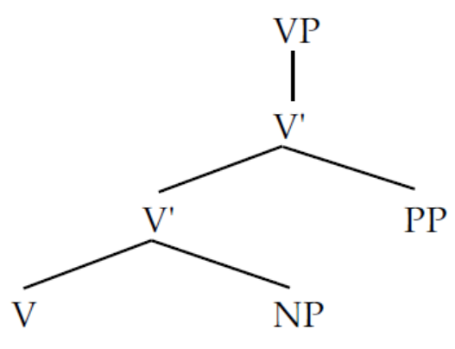
For this to work, we need the following rules:
18) VP → V’
19) V’ → V' (PP) or V' (AdvP)
20) V’ → V (NP)
The tree structure for the VP in (14) will look like (21).
21)
Rule (18) generates the VP and the V' under it;
the next rule (19) expands the top V' into another V' and a PP.
Finally, the lower V' is expanded into V and NP by rule (20).

Slide 16
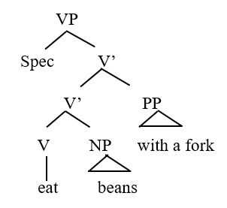
We can check what forms constituent in the sentence this way:
a. I [eat beans with a fork].
b. I [eat beans] [with a fork].

Slide 17
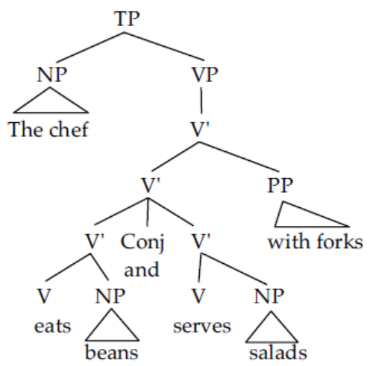
Similarly, conjunction seems to show an intermediate V' projection:
23) The chef [eats beans] and [serves salads] with forks.
The tree for a structure like this requires a V' node:
24)

Slide 18
try CPS 1.
COMPLEMENTS VS. ADJUNCTS in NPs
Using the tests you have been given (reordering, adjacency, conjunction of likes, one replacement)
determine whether the PPs in the following NPs are complements or adjuncts. Give the examples that you used in constructing your tests. Some of the NPs have multiple PPs. Be sure to answer the question for every PP in the NP.
a) a container [of flour]
b) a container [with a glass lid]
c) the collection [of figurines] [in the window]
d) the statue [of Napoleon] [on the comer]
e) every window [in the building] [with a broken pane]
f) the cat [by the window]

Slide 19
1.2 Adj-bar and Adv-bar
The arguments for intermediate structure in AdjPs are a little trickier, as English seems to limit the amount of material that can appear in an AdjP.
However, we do see such structure in phrases like (25):
25) the [very [[bright blue] and [dull green]]] gown
In this NP, bright clearly modifies blue, and dull clearly modifies green.
One possible interpretation of this phrase (although not the only one) allows very to modify both bright blue and dull green.

Slide 20
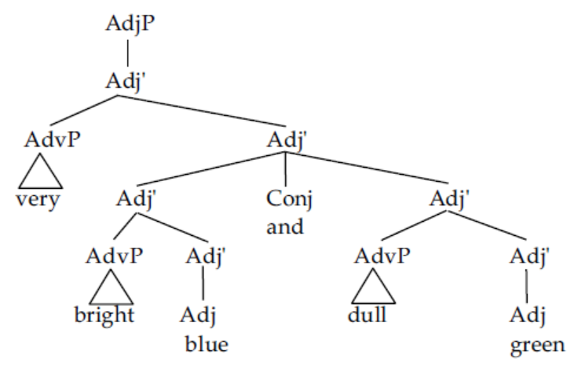
If this is the case, then the structure must minimally look like (26).
26)
This must be the structure so that the AdvP can modify both bright blue and dull green.

Slide 21
Under certain circumstances, some adjectives appear to allow prepositional modifiers to follow them:
27) I am afraid / frightened of tigers.
28) I am fond of clowns.

Slide 22
These post-adjectival PPs parallel the direct object of related verbs:
29) I fear tigers.
30) I like clowns.
Consider now:
31) I am [[afraid/frightened of tigers] and [fond of clowns] without exception].
Under one reading of this sentence, without exception modifies both afraid of tigers and fond of clowns.
Again, this would seem to suggest that the sentence has the constituency represented by the above bracketing, which points towards an intermediate category of Adj’.
32) Bob is [very [serious about Mary]], but [less [so]] than Paul.
The adjective phrase here is very serious about Mary, but so-replacement only targets serious about Mary.

Slide 23
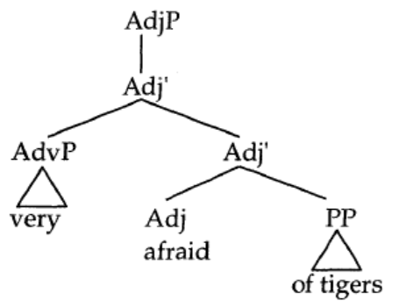
The rules that generate these structures are in (33-35). A sample tree for the AdjP very afraid of tigers is in (36 ).
33) AdjP → Adj’
34) Adj’ → (Adv P) Adj’
35) Adj’ → Adj (PP)
36)

Slide 24
1.3 P-bar
Consider the following sentences:
37) John placed it [right [in the middle of the table]].
38) John was [[in love] with his boss].
39) John was [utterly [in love]].
In these examples, we have what appear to be prepositional phrases
(in the middle of the table, in love)
that are modified by some other element: right, with his boss, and utterly, respectively.

Slide 25
Note, however, that you can target smaller units within these large PPs with constituency tests:
40) John knocked it [right [off the table] and [into the trash]].
41) John was [[in love] and [at odds] with his boss].
42) John was [utterly [in love]], but Louis was only [partly [so]].
Examples (40) and (41) show conjunction of the two smaller constituents.
Example (42) is an example of so-replacement.
Let us call the smaller constituent here P' on a parallel with N', Adj', and V'.

Slide 26
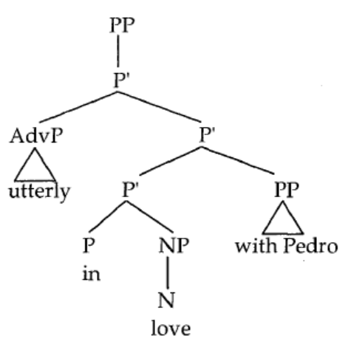
The rules that generate PPs are given below, and a tree showing an X-bar structure for the PP utterly in love with Pedro is seen in (46):
43) PP → P’
44) P’ → P’ (PP) or (AdvP) P'
P’ → P (NP)
46)

Slide 27
With this, we complete our introduction of intermediate structure.
In developing our phrase structure system, we've managed to complicate it significantly.
In the next section, we look at ways to simplify the rule system yet capture all the constituency facts we’ve considered here.

Slide 28
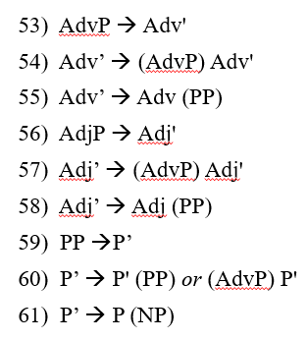
2. GENERALIZING THE RULES: THE X-BAR SCHEMA
For each of the major phrase types (NPs, VPs, AdjPs, AdvPs, and PPs) we have come up with three rules, where the first and second rules serve to introduce intermediate structure.
Let's repeat all the rules here.
47) NP → (D) N'
48) N’ → (AdjP) N' or N' (PP)
49) N’ → N (PP)
50) VP → V'
51) V’ → V' (PP) or V' (AdvP)
52) V’ → V (NP)

Slide 29
First, note that in all the rules above, the category of the rule is the same as the only element that is not optional.
For example, in the NP rule, the element that isn't optional is N'. This is the same part of speech.
Similarly, the only obligatory element in N' is either another N' or N.
This is a very general notion in phrase structure; we call it headedness.
All phrases appear to have heads.
A head is the most prominent element in a phrasal category and gives its part of speech category to the whole phrase.

Slide 30
Note that we don't have any rules of the form:
62) * NP → V AdjP
This rule not only seems meaningless, it is unattested in the system we've developed here.
The requirement that phrases are headed is called endocentricity.
The only obligatory element in a phrase is the head.

Slide 31
Second, note that with the exception of the determiner in the NP rule, all non-head material in the rules is both phrasal and optional.
We never find rules of the form:
63) * V’ → Adv V
With the exception of the determiner, anything in an X-bar rule that isn't a head must be a phrase and optional.

Slide 32
Finally, notice that for each major category there are three rules,
one that introduces the NP, VP, AdvP, AdjP, and PP,
one that takes a bar level and repeats it (e.g., N’ → N’ (PP)), and
one that takes a bar level and spells out the head (e.g., N’ → N (PP)).
We seem to be missing the generalization that for each kind of phrase, the same kinds of rules appear.
X-bar theory is an attempt to capture these similarities among rules.

Slide 33
We can condense the rules we've proposed into a simple set.
To do this we are going to make use of variables (like variables in algebra) to stand for particular parts of speech.
Let X be a variable that can stand for any category N, V, Adj, Adv, P.
XP is a catch-all term to cover NP, VP, AP, and PP.
Similarly, X' stands for N', V', Adj', Adv', and P’,
and X represents N, V, Adj, Adv, and P.

Slide 34
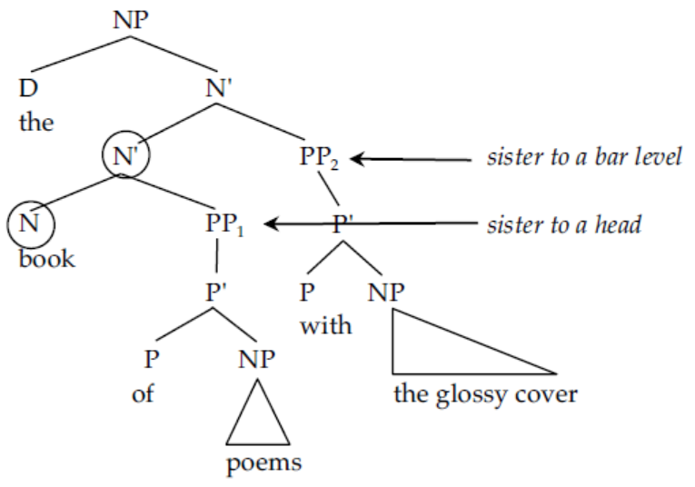
3. COMPLEMENTS, ADJUNCTS, AND SPECIFIERS
Consider now the two prepositional phrases that are subconstituents of the following NP:
70) the book [_{PP} of poems] [_{PP} with the glossy cover]
Using the X-bar ru1es, we can generate the following tree for this NP:
71)

Slide 35
You'll note that the two PPs in this tree are at different levels in the tree.
The lower PP₁ is a sister to the head N (book), whereas the higher PP₂ is a sister to the N’ dominating the head N and PP₁.
You'll also notice that these two PPs were introduced by different rules.

Slide 36
PP₁ is introduced by the rule:
72) X' ~X (WP)
and PP2 is introduced by the higher-level rule:
73) X' ~X' (ZP)
An XP that is a sister to a head (N, V, A, or P) is called a complement.
PP₁ is a complement. Complements roughly correspond to the notion "object" in traditional grammar
XPs that are sisters to single bar levels (N', V', A', or P') and are daughters of an X' are called adjuncts. PP₂ is an adjunct.

Slide 37
Adjuncts often have the feel of adverbials or obliques and are typically optional additional information.
74) Adjunct: An XP that is a sister to a single bar level (N', V', A', or P') and a daughter of a single bar
level (N', V', A', or P’).
75) Complement: An XP that is a sister to a head (N, V, A, P), and a daughter of a single bar level (N’,
V', A', or P’).
The rules that introduce these two kinds of XPs get special names:
76) Adjunct rule: X’ → X' (ZP)
77) Complement rule: X’ → X (WP)

Slide 38
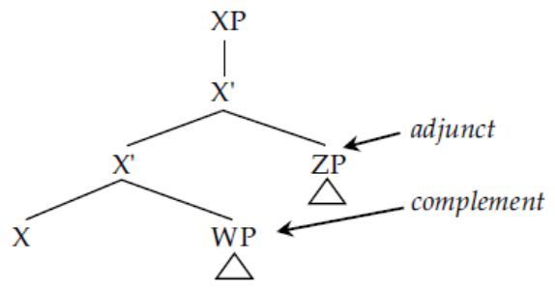
A tree showing the structural difference between these is given below:
78)
If there really are two different kinds of PP within an NP, then we expect that they will exhibit different kinds of behavior.
It turns out that this is true: There are significant differences in behavior between adjuncts and complements.

Slide 39
3.1 Complements and Adjuncts in NPs
Let’s take NPs as a prototypical example. Consider the difference in meaning between the two NPs below:
79) the book of poems (The big book of poems with the blue cover)
80) the book with a red cover
Although both these examples seem to have, on the surface, parallel structures (a determiner, followed by a noun, followed by a prepositional phrase), in reality they have quite different structures.

Slide 40
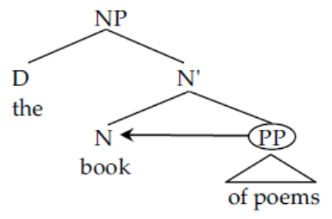
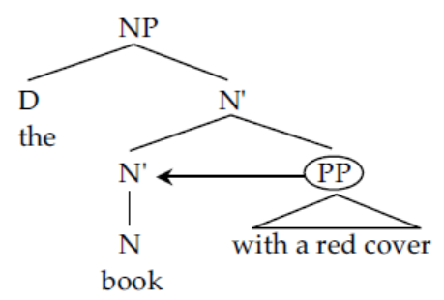
The PP in (79) is a complement and has the following tree:
81)
You'll note that the circled PP is a sister to N, so it is a complement.
By contrast, the structure of (80) is:
82)
Here the PP with a red cover is a sister to N', so it is an adjunct.

Slide 41
The difference between these two NPs is not one that you can hear or grasp easily.
The difference between the two is in terms of the amount of structure in the tree.
In (82), there is an extra N'. While this difference may at first seem abstract, it has important implications for the behavior of the two PPs.
Consider first the meaning of our two NPs.
In (79), the PP seems to complete (or complement) the meaning of the noun.
It tells us what kind of book is being referred to.
In (80), by contrast, the PP seems more optional and more loosely related to the NP.
This is a highly subjective piece of evidence, but it corresponds to more syntactic and
structural evidence too.

Slide 42
Let’s see this for Complement and Adjunct:
[The big book of poems with the blue cover] is on the table.
a. the big book [of poems]
b. the big book [with a red cover]
c. the big book [of poems] [with a red cover]
d. the [big [book [of poems] [with a red cover]]]
So, there is hierarchy within the NP.

Slide 43
Think carefully about the two rules that introduce complements and adjuncts.
There are several significant differences between them. These rules are repeated here for your
convenience:
83) Adjunct rule: X' -+X' (ZP)
84) Complement rule: X' -+X(WP)
First observe that because the complement rule introduces the head (X),
the complement PP will always be adjacent (close) to the head
since complements are sisters to the head.
But adjuncts may be separated from the head.

Slide 44
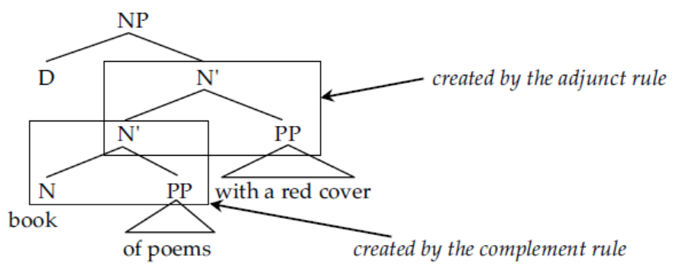
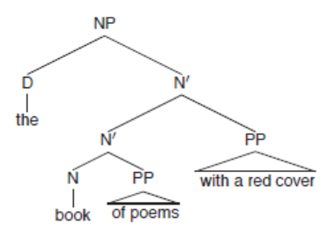
Or more particularly, it will always be closer to the head than an adjunct PP will be.
This is seen in the following data:
85) the book [of poems] [with a red cover]
head complement adjunct
86) *the book [with a red cover] [of poems]
head adjunct complement
You can see how this is true if you look at the tree for sentence (83):
87)

Slide 45
The complement rule does not have this property.
On the left side of the rule there is an X', but on the right there is only X So the rule cannot apply iteratively.
That is, it can only apply once within an XP.
What this means for complements and adjuncts is that you can have any number of adjuncts (89), but you can only ever have one complement (90):
89) the book [of poems] [with a red cover] [from Blackwell] [by Robert Burns]
head complement adjunct adjunct adjunct
90) *the book [of poems] [of fiction] [with a red cover]
head complement complement adjunct

Slide 46
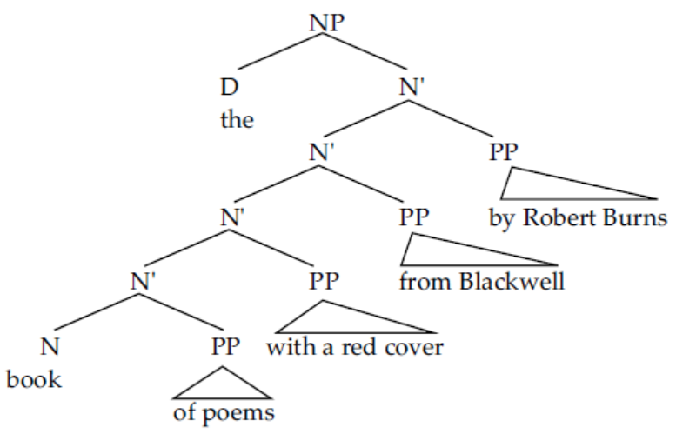
The tree for (89) is given below; you'll note that since there is only one N, there can only be one complement, but since there are multiple N's, there can be as many adjuncts as desired.
91)

Slide 47
A phrase can have multiple adjuncts, but only one complement.
Related to the facts that the number of adjuncts is unlimited, but only one complement is allowed/ and complements are always adjacent to the head, observe that you can usually reorder adjuncts with respect to one another, but you can never reorder a complement with the adjuncts:
92)
a) the book of poems with a red cover from Blackwell by Robert Burns
b) the book of poems from Blackwell with a red cover by Robert Burns
c) the book of poems from Blackwell by Robert Burns with a red cover
d) the book of poems by Robert Burns from Blackwell with a red cover
e) the book of poems by Robert Burns with a red cover from Blackwell
f) the book of poems with a red cover by Robert Burns from Blackwell
g) *the book with a red cover of poems from Blackwell by Robert Burns
h) *the book with a red cover from Blackwell of poems by Robert Burns
i) *the book with a red cover from Blackwell by Robert Burns of poems
(etc.)

Slide 48
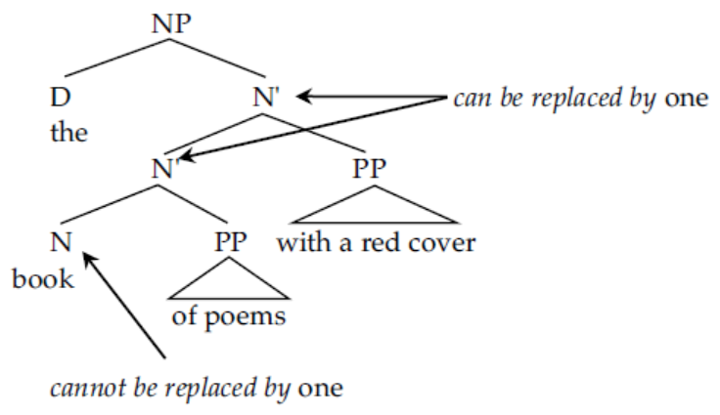
There is one final difference between adjuncts and complements that we will examine here. Recall the test of one-replacement:
94) One-replacement: Replace an N' node with one. (= one can replace an N’ node.)
This operation replaces an N' node with the word one. Look at the tree in (95):
95)

Slide 49
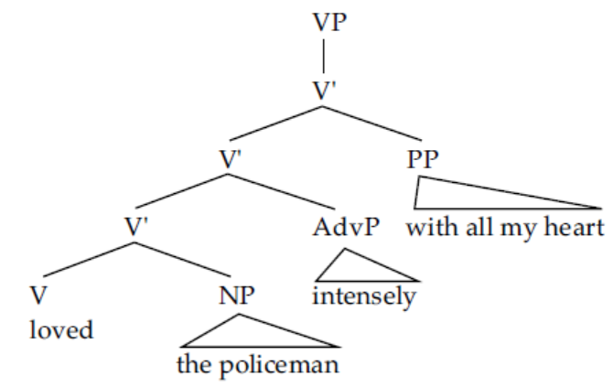
3.2 Complements and Adjuncts in VPs, AdjPs, AdvPs, and PPs
The distinction between complements and adjuncts is not limited to NPs; we find it holds in all the major syntactic categories.
The best example is seen in VPs.
The direct object of a verb is a complement of the verb. Prepositional and adverbial modifiers of verbs are adjuncts:
99) I loved [the policeman] [intensely] [with all my heart].
V direct object adverbial PP phrase
complement adjunct adjunct
100)

Slide 50
Direct objects must be adjacent to the verb, and there can only be one of them.
101) a) *I loved intensely the policeman with all my heart.
b) *I loved the policeman the baker intensely with all my heart.

Slide 51
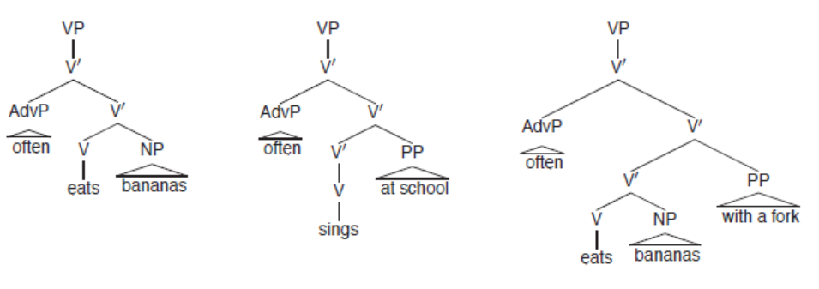
Complement/Adjunct Distinction in VPs
a. John often eats [bananas].
b. John often sings [at school].
c. John often eats [bananas] [with a fork].

Slide 52
In general, complements of all categories (N, V, A, P, etc.) are the semantic objects of the head.
Consider for example all the complements below:
103) a) Toni fears dogs. (verb)
b) Toni is afraid of dogs. (adjective)
c) Toni has a fear of dogs. (noun)
In all these sentences, ( of) dogs is a complement.

Slide 53
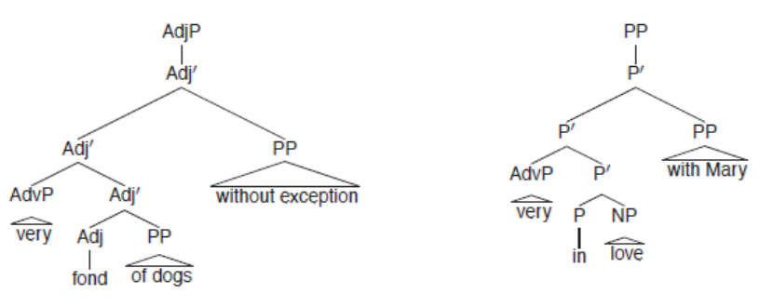
Complement/Adjunct Distinction in AdjPs and PPs
a. John is very fond [of dogs] [without exception].
b. John is very in [love] [with Mary].
We can apply similar tests as before: one complement, multiple adjuncts, reordering of adjuncts, and conjunction.

Slide 54
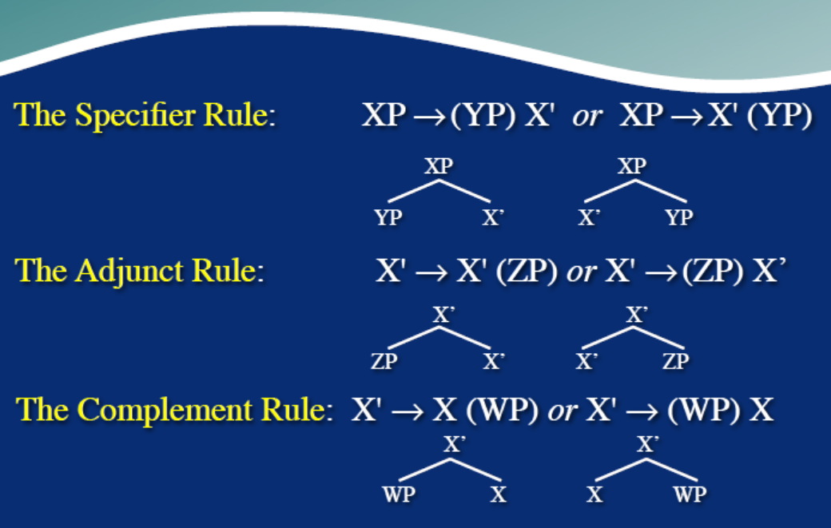
Generalized X-bar Rules

Slide 55
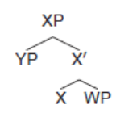
3.3 The Notion of Specifier
In the section 3.1 above, we introduced two structural notions: adjuncts and complements.
These correspond to two of the three X-bar rules:
104) a) Adjunct rule: X’ → X' (ZP) or X’ → (ZP) X’
b) Complement rule: X’ → X (WP)
The third rule also introduces a structural position: the specifier.
105) Specifier rule: XP → (YP) X'

Slide 56
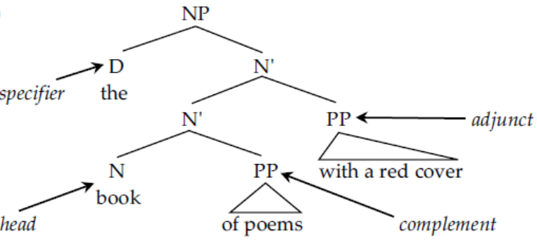
We have only seen one specifier so far - the determiner in NPs:
106) [the] [book] [of poems] [with a red cover]
specifier head complement adjunct
107)
Later on, we’ll argue that even determiners aren’t real specifiers.
The specifier is defined as the daughter of XP and sister to X’:
108) Specifier: An YP that is a sister to an X' level, and a daughter of an XP.
(For now, just understand the X-bar theoretic definition of specifiers (sister of X’, daughter of XP), and put determiners there).

Slide 57
We can show that specifiers are different from adjuncts and complements.
Since the specifier rule is not recursive, you can only have one specifier:
109) *the these red books
The specifier rule has to apply at the top of the structure.
This means that the specifier will always be the leftmost element (in English, remember the SVO word order):
110) *boring the book
The above example also shows that specifiers can't be reordered with respect to other adjuncts or
complements.

Slide 58
As the final difference between specifiers and other types of modifier, specifiers can only be conjoined with other specifiers:
111) a) two or three books
b) *two or boring books
On the surface, the usefulness of this position may seem obscure, since only determiners appear in it.

Slide 59
5. PARAMETERS OF WORD ORDER
In this module, and thus far in this book, we've been concentrating primarily on English.
The reason for this is that it is a language accessible to us all.
However, syntacticians aren't interested only in English.
One of the most interesting parts of syntax is comparing the sentence structure of different languages
The X-bar rules we've developed so far for English do an acceptable job of accounting for the order of constituents and hierarchical structure of English:
115) a) Specifier rule: XP → (YP) X’
b) Adjunct rule: X’ → X' (ZP) or X' ~ (ZP) X'
c) Complement rule: X’ → X (WP)

Slide 60
They don't, however, account well for other languages.
Consider the position of direct objects (complements) in Hindi. In Hindi, the complement precedes the head:
116) Eg. Hindi
a. raajiiv kavitaa likh-egaa
rajiv poem write-FUT
S O V
‘Rajiv will write a poem.’
b. raajiiv-ne sariitaa ko kapRe di-ye
rajiv-ERG sarita to cloths give-PERF
S IO DO V
‘Rajiv gave cloths to Sarita.’
The complement precedes the verb unlike English word order structure.

Slide 61
Not all languages put the complement on the right-hand side like English.
Not all languages put the specifier before the head either.
Our rules, while adequate for English, don't rea11y get at the syntactic structure of languages in general.
Remember, syntax is the study of the mental representation of sentence structure.
It will be good if our theory accounted for both the similarities and the differences among languages.

Slide 62
X-bar theory provides us with an avenue for exploring the differences and similarities among languages.
Let's start by generalizing our rules a little bit.
Let's allow specifiers and adjuncts to appear on either side of the head:
117) a) Specifier rule: XP → (YP) X’ or XP → X' (YP)
b) Adjunct rule: X’ → X' (ZP) or X’ → (ZP) X'
c) Complement rule: X’ → X (WP) or X’ → (WP) X

Slide 63
Each of these rules has two options. The specifier complement / adjunct can all appear on either side of their respective heads.
Obviously, these rules are now too general to account for English.
If these rules, as stated, were adopted straight up, they would predict the grammaticality of sentences like:
118) *[_{NP} Policeman the] [_{vP} Mary kissed].
(meaning The policeman kissed Mary.)
It would be a bad thing to do this. At the same time, constituent orders like those of Hindi in fact exist, so this clearly is an option.
Our theory must capture both facts: That the object-verb (OV) order is an option that languages use, and that it isn't the option used by English.

Slide 64
The way that generative syntacticians accomplish this is by claiming that the rules in (117) are the possibilities universally available to human beings.
When you acquire a particular language, you select one of the options in the rule, based upon the input you hear from your parents.
Take, for example, the complement rule.
In English, complements of verbs follow the verbal head.
In Hindi, they precede the head. There are two options in the rule:
119) a) X’ → X (WP)
b) X’ → (WP) X
The child learning English will adopt option (a).
The child learning Hindi will adopt option (b). These options are called parameters.

Slide 65
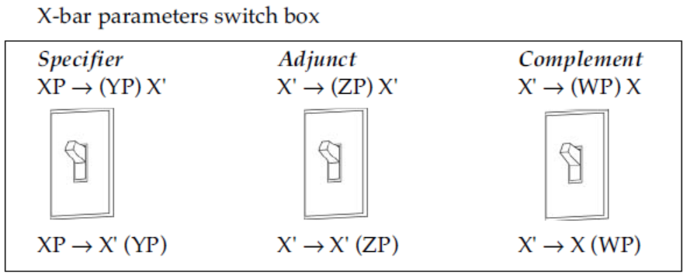
Take, for example, the complement rule.
In English, complements of verbs follow the verbal head.
In Hindi, they precede the head. There are two options in the rule:
119) a) X’ → X (WP)
b) X’ → (WP) X
The child learning English will adopt option (a).
The child learning Hindi will adopt option (b). These options are called parameters.
120)
When you are a child acquiring your language, you subconsciously set these switches, to tell you which
version of the rules to use.

Slide 66
Notice that this gives us a very simple system for acquiring the word order of our languages.
There are a finite set of possibilities, represented by the different settings of the parameters.
English sets its complement parameter so that the complement follows the head.
Hindi sets it the other way. The child only has to hear a small amount of data (perhaps even as little as one sentence) to know what side of the head complements go in their language.

Slide 67
Once children have set the parameter, they can apply the right version of the rule and generate an unlimited number of sentences.
The following show how English sets its X-bar parameters:
121) a) Specifier specifier on left, head on right (XP → (YP) X’)
e.g., the book
b) Adjunct both options allowed (X’→ (ZP) X' and X’ → X' (ZP))
e.g., yellow roses; books from Poland
c) Complement head on left, complement on right (X’ → X (WP))
e.g., books of poems; John kissed his mother.

Slide 68
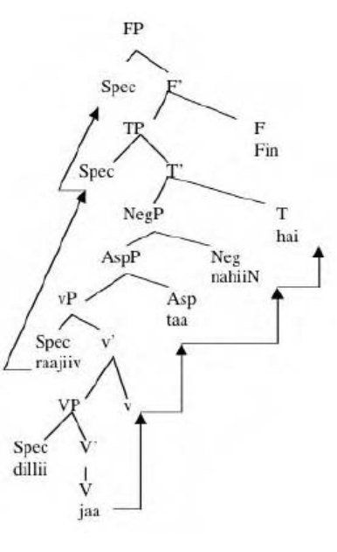
Some Hindi examples
(1) raajiiv dillii nahiiN jaa-taa hai
rajiv delhi NEG go-HAB is
‘Rajiv does not go to Delhi.’

Slide 69
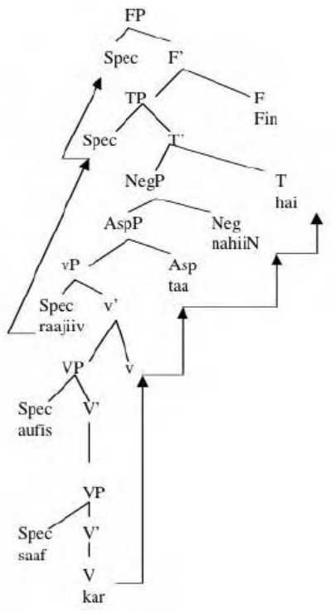
(2) raajiiv aufis saaf nahiiN kar-taa
rajiv office clean clean do-HAB
‘Rajiv does not clean the office.’

Slide 70
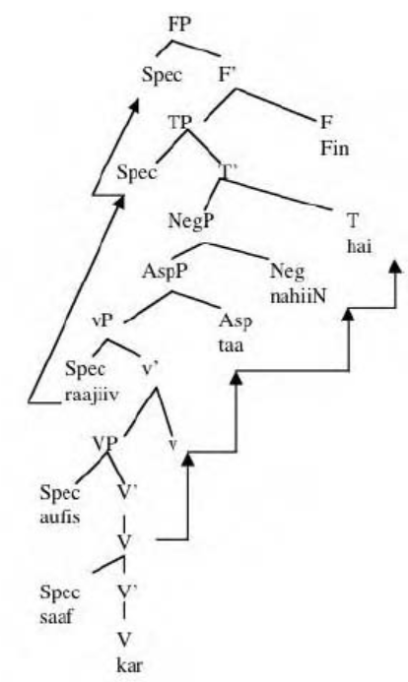
(3) raajiiv aufis nahiiN saaf kar-taa
rajiv office NEG clean do-HAB
‘Rajiv does not clean [the?] office.’

Slide 71
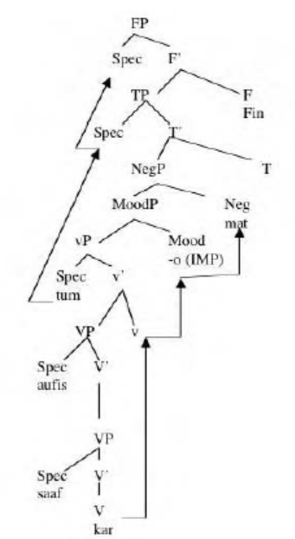
(4) (tum) aufis saaf mat kar-o
you office clean NEG do-IMP
‘Do not clean the office.’

Slide 72
Conclusion
To account for all possible word orders, we need to generalize the X-bar schema.
Specifier Rule: XP → (YP) X or XP → X (YP)
Adjunct Rule: X → X (ZP) or X → (ZP) X
Complement Rule: X → X (WP) or X → (WP) X
• The side that specifiers/adjuncts/complements appear on can vary depending upon the language.

Slide 73
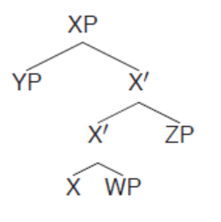
X-bar Theory: Remember this
• Rules
Specifier Rule: XP → (YP) X
Adjunct Rule: X → (ZP) X or X → X (ZP)
Complement Rule: X → X (WP)
• Terminology
Specifier (YP): daughter of XP, sister to X.
Adjunct (ZP): daughter of X, sister to X.
Complement (WP): daughter of X, sister to X.

Slide 74
i) Specifier: Sister to X', daughter of XP.
ii) Adjunct: Sister to X', daughter of X'.
iii) Complement: Sister to X, daughter of X'.
iv) Head: The word that gives its category to the phrase.
v) Projection: The string of elements associated with a head that bear the same
category as the head (N, N', N', N', NP, etc.).
vi) Maximal Projection: The topmost projection in a phrase (XP).
vii) Intermediate Projection: Any projection that is neither the head nor the phrase (i.e., all the X' levels).

Slide 75
Reference
Carnie, A. (2021). Syntax: A Generative Introduction (Fourth Edition). Wiley Blackwell.
Kumar, R. (2006). Negation and Licensing of Negative Polarity Items in Hindi Syntax. Routledge Publications.

